Slide 1
Secured Data Hiding in images using steganography
CAPSTONE PROJECT
Presented By: Vidya C
Student Name : Vidya c
College Name & Department : City Engineering College & Computer Science Department

Slide 2
OUTLINE
Problem Statement
Technology used
End users
Result
Conclusion
Git-hub Link
Future scope

Slide 3
Problem Statement
In today’s digital world, keeping sensitive data secure is a major challenge.
Traditional encryption methods protect data but can make it obvious that something is hidden.
Steganography helps by secretly embedding data inside images, making it almost impossible to detect.
This project focuses on securely hiding data in images while keeping the image quality intact.
The goal is to enhance privacy and protect information from unauthorized access.

Slide 4
Technology used
Libraries Used:
Python: Main programming language for implementation.
OpenCV: Image processing and manipulation.
Pillow (PIL): Handling image formats and modifications.
NumPy: Efficient numerical operations on image data.
Cryptography: For encryption (e.g., AES) before hiding data.
Stegano: Pre-built steganography functions for embedding and extracting data.
Matplotlib (Optional): Visualization of image modifications.
Platform Used:
Operating Systems: Windows, Linux, or macOS (Cross-platform support).
IDE: PyCharm, VS Code, or Jupyter Notebook for development.
Google Colab (Optional): Cloud-based execution without local setup.
GitHub/GitLab: Version control and project collaboration.
SQLite/MySQL (Optional): Storing encrypted references (if needed).
Tkinter/PyQt (Optional): GUI development for user-friendly interaction.

Slide 5
End users
Cybersecurity Professionals:
Use steganography to hide sensitive data within images for secure communication.
Helps prevent unauthorized access and data leaks.
Ensures confidential data remains undetectable even if intercepted.
Useful for secure messaging and transmitting classified information.
Often combined with encryption for enhanced security.

Slide 6
Businesses & Corporations:
Protects trade secrets, financial records, and intellectual property.
Embeds sensitive data in images to prevent cyber threats.
Ensures hidden data remains secure even if files are accessed.
Used for digital watermarking to prevent counterfeiting and piracy.
Strengthens overall data security and prevents unauthorized access.

Slide 7
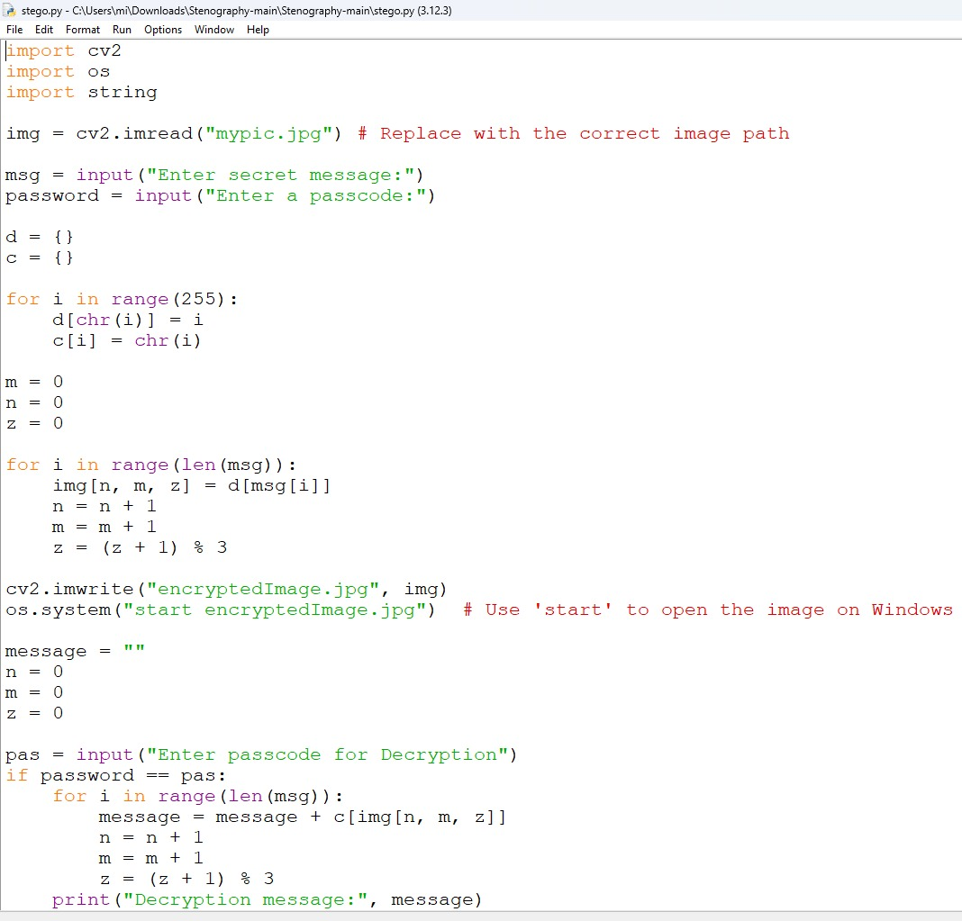
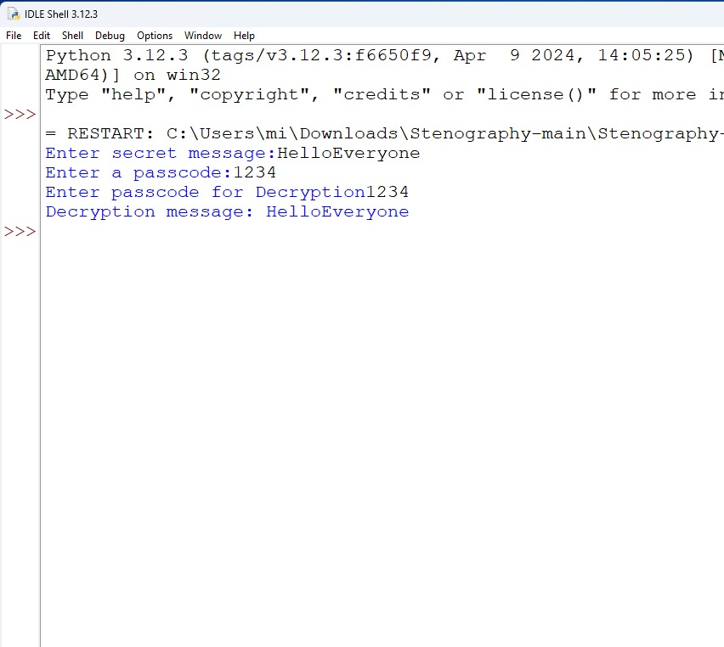
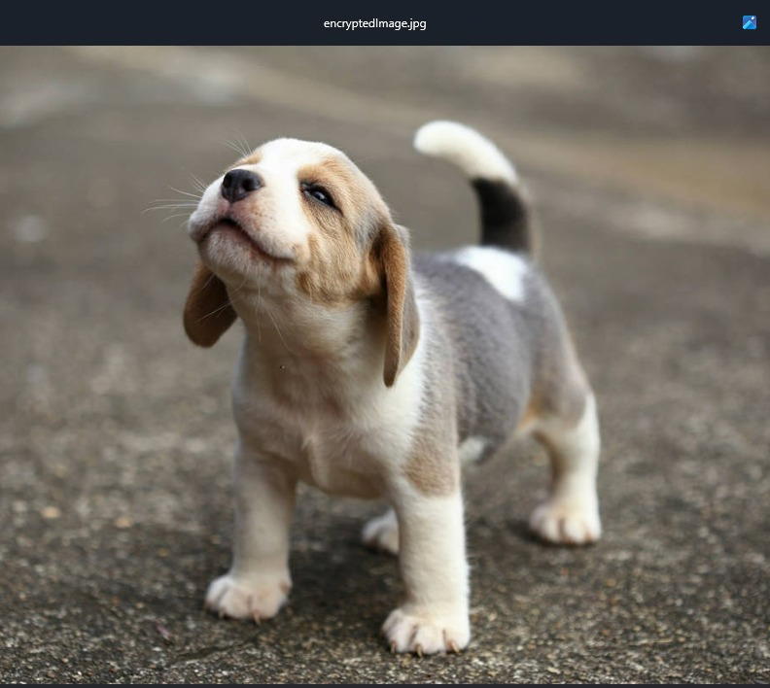
Results

Slide 8
Conclusion
This project successfully implements steganography to securely hide data in images.
It addresses the challenge of confidential data transmission without attracting attention.
Unlike traditional encryption, steganography ensures data remains undetectable within digital images.
Techniques like Least Significant Bit (LSB) and AES encryption enhance both security and secrecy.
The method maintains image quality while embedding data, making it practical for real-world applications.
This approach strengthens data protection, ensuring privacy and preventing unauthorized access.

Slide 9
GitHub Link
https://github.com/vidyac-hub/Secure-Data-Hiding-in-Images-using-Stenography

Slide 10
THANK YOU

